Slide 1


Constraints

Slide 2


Constraints
Budget: $400
Hardware Requirements:
Must use PIC32 microcontrollers as the processors
Must use provided Zumo motors
Must use a robotic arm that costs less than $75
Cannot use a line follower array
Cannot use an overhead camera

Slide 3
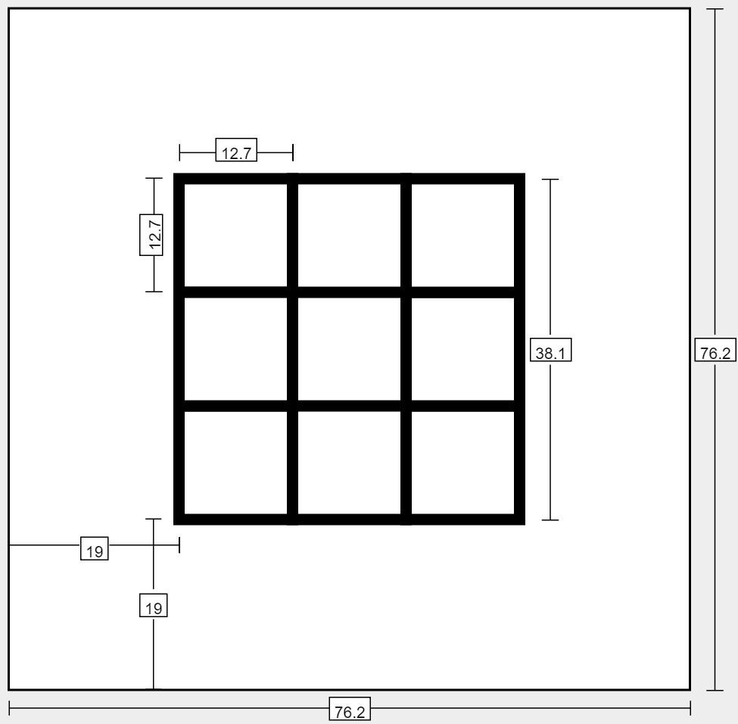
Project Requirements
38.1 cm by 38.1 cm Tic-Tac-Toe board with 12.7 cm by 12.7 cm squares
A rover with the robotic arm will move around the game board to draw tokens
The arm must draw the ‘X’s to be at least 4 cm long and ‘O’s to be at least 4 cm in diameter.
The ‘X’s and ‘O’s must be completely in the target square
The user will interact with a GUI to select moves

Slide 4
Robot Arm

Slide 5
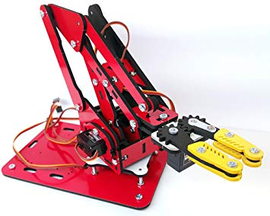
Choice of Robot Arm
Decided on a 4-Servo ArmUno 2.0 - 3 axis motion + claw for the servo
Within the price constraints of the project,
and large enough to manipulate a dry erase
marker as needed

Slide 6
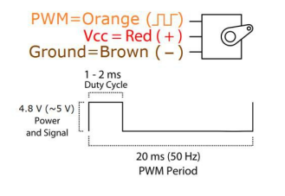
Robot Arm Control
Each of the arm servos is controlled by a pulse width modulated signal with a 20ms period.
An arm control library provides an API tell the arm to perform complex and simple motions.
Simple motions are things like setting a servo angle. Complex motions are time dependant motion paths, defined as a series of arm positions and the speed to move between them.

Slide 7
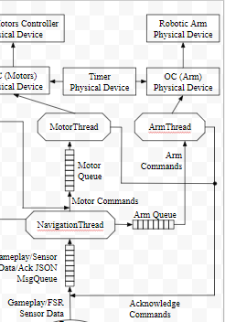
Integration
To meet the project requirements, complex motions to draw “X” and “O” were created
The arm thread performs actions depending on a sent of enumerated command messages sent to it
After finishing each action, the arm thread sends and acknowledge message back to the navigation thread to indicate it is done.

Slide 8
Motors

Slide 9
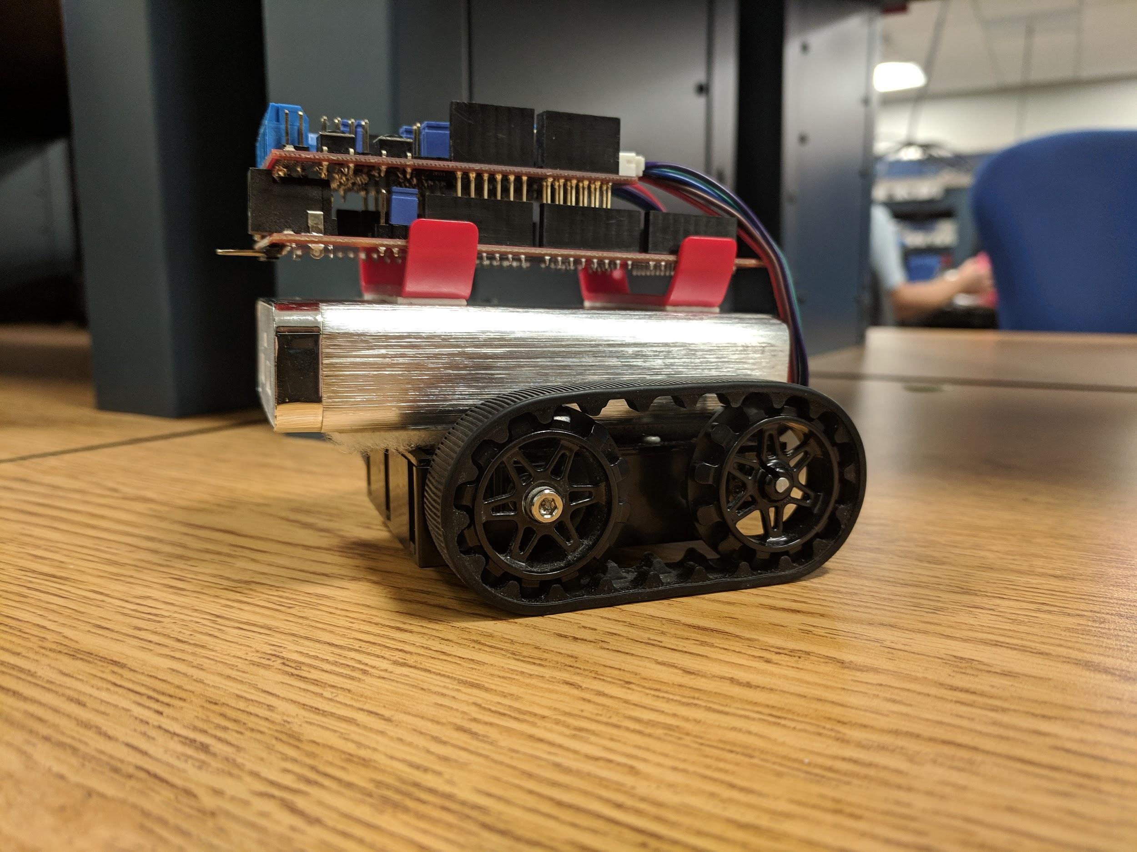
Motor Control
Designed an API to:
Move rover forwards/backwards a given distance using encoders
Turn rover left/right a given angle using encoders
Asynchronously stop the motors
Incorporate a PID feedback control loop

Slide 10
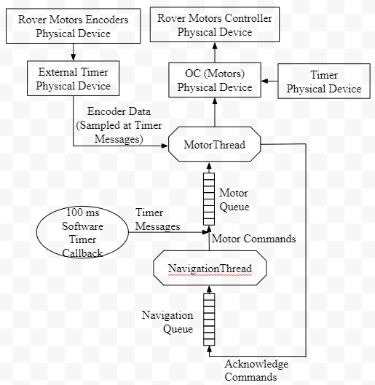
Implementation
Motor Thread:
Receives movement commands from navigation thread in it’s queue and controls the motors accordingly
Reads encoder values when timer messages are received every 100 ms in it’s queue and adjusts the motor PWM signals accordingly
Acknowledges sent to navigation queue when movements are complete

Slide 11
Sensors

Slide 12
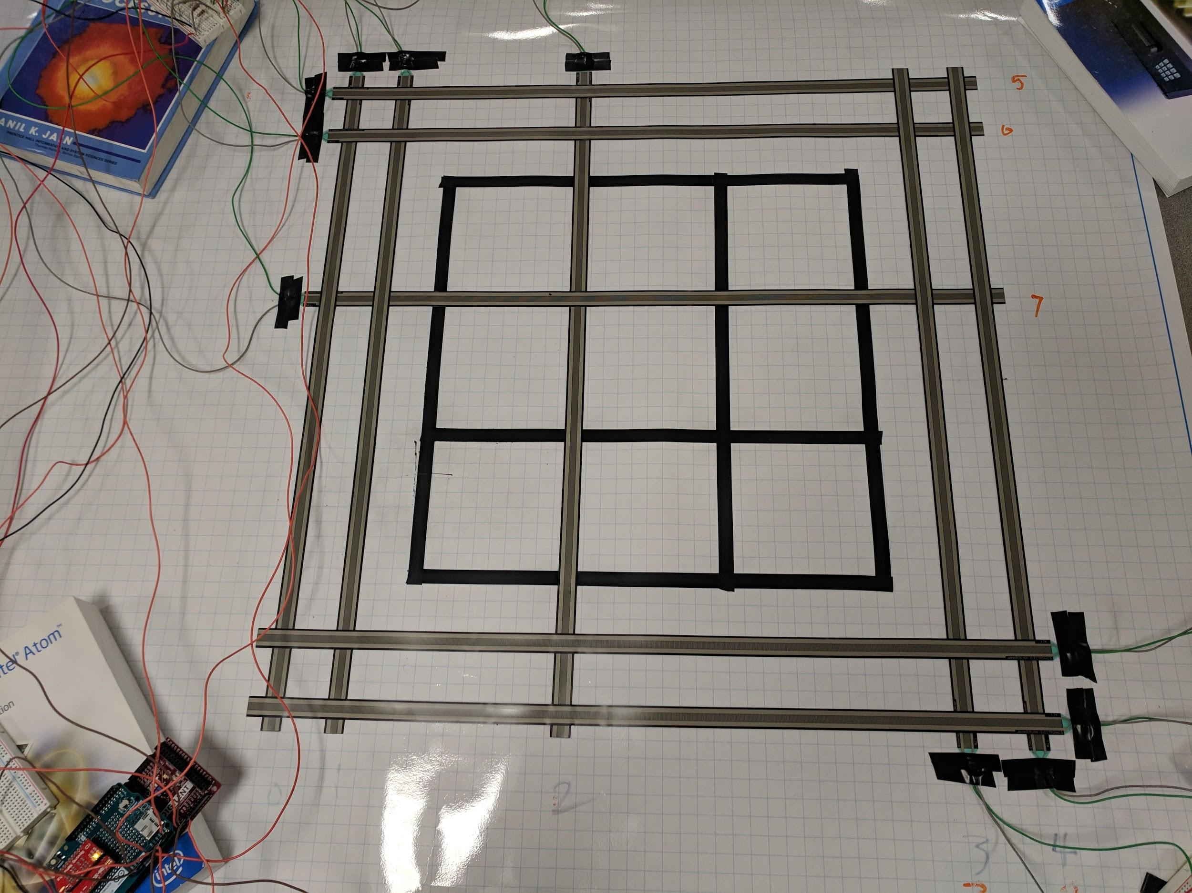

Force Sensitive Sensors
Sensors are used to determine the rover’s location.
Sensor Type: Extra Long Force Sensitive Resistors
Functionality:
Resistance is based on the amount of pressure applied
Pressure decreases the resistance which in turn increases the Analog to Digital Converters readings
Notes:
Based on project specifications we were unable to use the line follower array or overhead camera for rover navigation on our game board. To autonomously navigate the board used Force Sensitive Resistors to determine the rover’s location. 10 Sensors were placed in a grid format around the game board. Each sensor has two pins, one is connected to the PIC’s 5V input and the other to a pull down resistor which is connected to ground. The connection point between the pull down resistor and the Force Sensitive Sensor is then wired to one of the analog inputs on the PIC. The sensors resistance is based on the amount pressure applied to them, so when rover drive on top of the sensor, the resistance will decrease which in turn increases the Analog to Digital Converters reading. The Analog to Digital Converter was configured to support multiple analog input readings, using ADC scan mode.

Slide 13
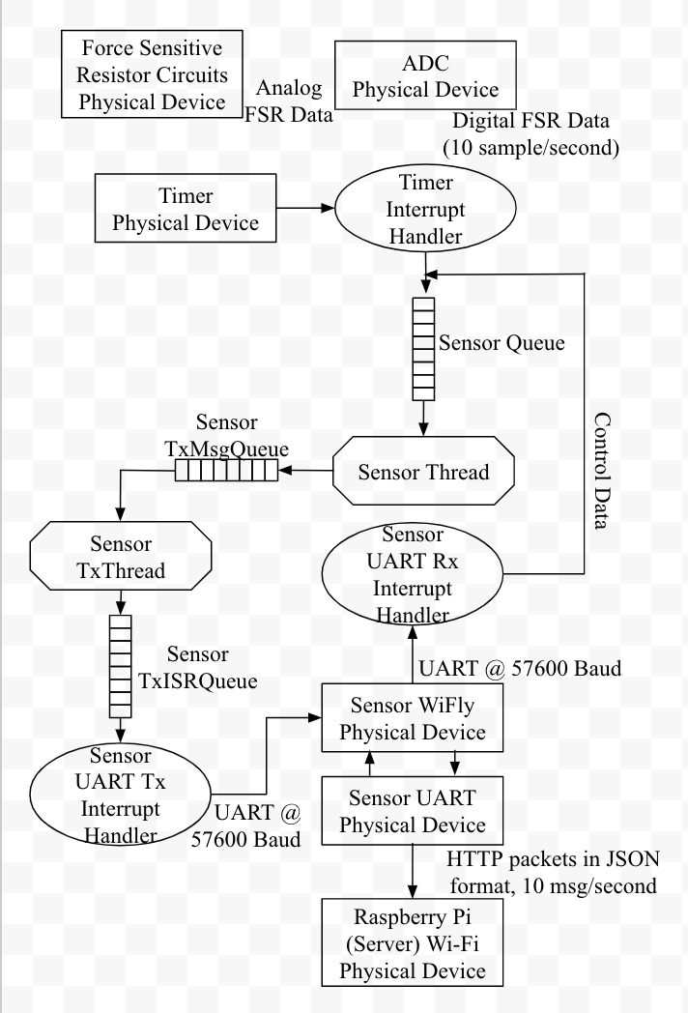
Implementation
Sensor Thread
Runs a calibration routine on start up.
Reads the value from the Analog to Digital Converter
Calls a conversion function:
Compares the read value at each pin with a threshold value to determine whether the sensor has pressure.
Sends the converted value to the server
Notes:
The Sensor Thread is ran on its own PIC. On startup the Analog to Digital Converter Interrupt will run a calibration routine that will take 2 readings of each Analog Pin. The two readings for each pin is then averaged together and the average value is then stored in a array The average value will sever as threshold comparison value that will be used in the conversion function.
This conversion function is also called in the interrupt. It takes the threshold value array as an input and return a 10 bit integer value as an output. Each bit in the integer value corresponds to a speciific sensor.
In the conversion function The value of each analog pin is compare to the corresponding threshold value in the array and if the pin's value is greater then the threshold, this indicates that the sensor has pressure on it.
The corresponding bit in the 10 bit integer value, is then converted to a 1. If there is no pressure, the corresponding bit value will remain a 0. This 10 bit value is then returned. The value is sent to the sensor queue.
In the main function of the program the value is then added to a json POST message which is sent to the server and stored in a database every half second.

Slide 14
Communications

Slide 15
Raspberry Pi HTTP Server
Raspberry Pi was used as an access point
Base Http Server that uses multithreading to handle multiple requests
MongoDB to store Post request data
Sends a Json response to the client
Notes:
The Communications for the project is done through Raspberry PI Http Server. The Raspberry Pi is configure as an access point that will allow external devices like the PICs and GUI client to connect to the server. The server is a Base HTTP Server that uses multithreading to handle multiple requests from different clients.
The server recieves POST requests from the Navigation Thread and the Sensor Thread, and data from each thread is then stored in a MongoDB database. The GUI Client and the Navigation Thread both send GET requests and specifc JSON messages are sent to each client.
The naviagation

Slide 16
Graphical User Interface

Slide 17
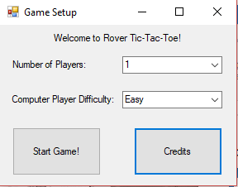
Settings GUI
Can select single player or two player mode
In single player, can select easy or hard difficulty for computer player
In easy mode, picks random open tile. In hard mode, uses priority algorithm to pick the best move.

Slide 18
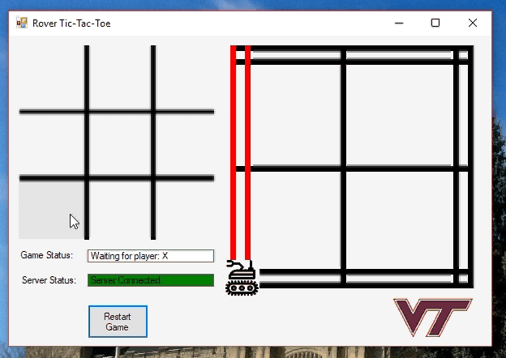
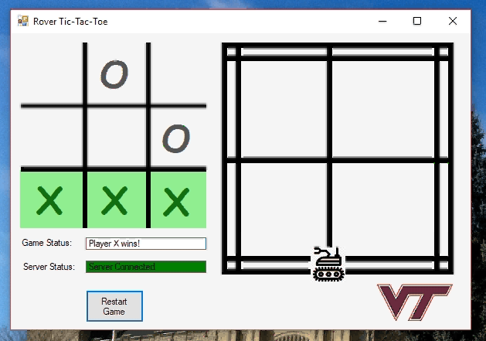
Gameplay GUI
Windows form GUI provides interface to enter human player moves and see computer player moves
Blocks entry of new moves until current move is done and shows when the game is over
Board on the left shows the current FSR state and the position of the rover on the board

Slide 19
Navigation

Slide 20
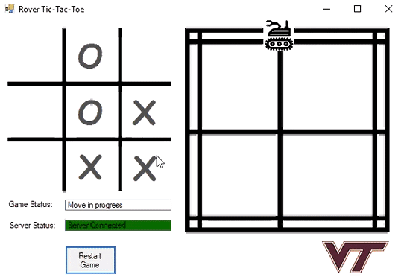
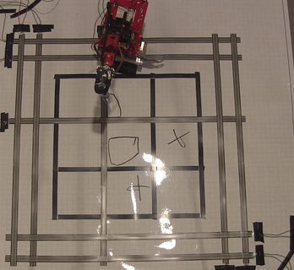
Direction and Mapping
After initialization the direction function is called, determining the shortest direction of travel.
The mapping state machine uses the current location as the state and changes states based on FSR input and Direction of travel.
Each state handles error.
Notes:
Once the gameplay GUI updates the database with a move the navigation algorithm kicks in. There are three parts to this algorithm, the Direction determining function, the Mapping state machine, and the Command function.
Upon startup the rover must be placed in the bottom left corner facing towards the right to meet initialization criteria. From here the Mapping state machine is called.
This state machine uses the Force Sensitive Resistor input given to the PIC by the server to switch states. Each state corresponds to a different position on the game board. Once a move has been delivered to the PIC from the server this function calls the Direction function.
The direction function has three outputs, clockwise, counter-clockwise, and stop. The direction function uses the current location and the next square to navigate towards to determine the optimal direction of travel. When this function outputs a direction the Mapping state machine can then send commands to the motors to correct for error when detected on the FSRs and when this function outputs a stop command that allows the command function to know to send a draw command.

Slide 21
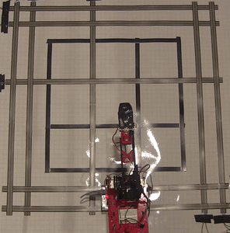
Command Function
Uses the direction, current position, FSR input, and the given move to send a series of commands to the motors and arm.
Set-distance
FSR reliant
Notes:
The Command function is the last of the Navigation algorithm’s fundamental parts. Using the output of the Direction state-machine, position function, and the input from the server this function sends the proper series of commands to the motors and arm. The vast majority of cammands were sent to the motor.
The commands sent to the motors were determined in one of two ways. Either a set distance to travel was sent, in which case the command function would spin waiting for an Acknowledge message, or a message to drive a short distance was sent repetitively until the FSR array indicated otherwise. The commands to drive a set distance were usually implemented to navigate around a corner or to align beside a square where the FSRs couldn’t supply accurate enough information to draw.
The short repetitive commands were used for the bulk of the navigation. The slow speed of travel allowed the FSR array to inform the rover when to stop, turn, send a set distance drive command, or allow the rover to correct its trajectory, whereas the set distance driving could throw the rover off the sensors.
After the rover found its way beside the target square this function would send a draw X or draw O command to the arm and wait for an acknowledge message before sending an acknowledge of its own to the server, allowing the server to send it another move command.

Slide 22
Reliability

Slide 23
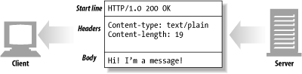
Software Reliability
All server communication done using HTTP messages with JSON data bodies - the protocol designed in such a way that no single message between server and PIC is critical and will result in failure if it does not send/receive.
Internal queues and communication on PIC used same struct for all threads, proved to be very consistent without failure/deadlock risk.
Used the Python BaseHTTP server library - during testing of the gameplay, had intermittent issue where the server would lock up and require a restart - this was the most significant software related consistency issue.

Slide 24

Hardware Reliability
More testing would be needed to get 100% reliability in board navigation.
Turning around corners ended up being the most difficult issue - high latency between the sensor PIC and rover PIC combined with uneven board (tape + wires) lead to a diminished turning accuracy for the rover.
Extensive testing of the arm draw “O” and draw “X” caused a degradation in the arm servos over time. Gradually lost ability to actuate to the necessary angles and would stall out - could be fixed with higher quality servos.

Slide 25
Robustness

Slide 26
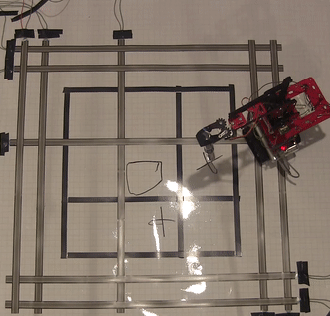
Handling under
extreme circumstances
When the rover is angled wrong with a tread depressing its respective sensor it will attempt to correct a set number of times every 5 seconds.
If a tread depresses the wrong sensor the error correction will kick the rover completely off track. The rover will need to be reset on the sensor network.
When the server fails to send updated FSR data to the rover the rover will not know to transition its current location internally.
The rover always drifted slightly left. If the rover was straddling only the right FSR on a straight the rover would correct itself.
Notes:
Robustness, or handling under extreme situations, is important to the success of a real-world system. As you can see in the GIF even when the rover is angled horribly wrong it still possesses the capability to correct itself back on track.
During testing when we would place the rover on the board at an angle we noticed overcorrection was a prominent issue. To counteract this problem we instituted a limitation on the number of correction commands that could be sent during a five second time interval.
A drawback in the implementation of our system was we were only able able to send the proper correction commands when the rover’s right tread depressed the outer resistor, and when its left tread depressed the inner resistor. If the rover managed to completely cross over one of these resistors the commands to correct itself would only throw it further off track and required a manual reset. This situation could occur after a set distance drive command was sent or if the server failed to send FSR data in a timely manner.
During testing the arm reliably drew the X and O symbols every time the command was sent. The arm’s only issue was the aforementioned server degrading through rigorous testing.
In our physical implementation it turned out the rover would always drift ever so slightly left, into the center of the board. So when the rover became offset with the left tread between the two outer resistors it would reliably correct itself back on track.

